Slide 1


SabarStor-simple E-Commerce Stor
Group:
RIM-140930
Under the supervsion of :
M. SAIF
Presented by:
SABAR Lebate
Sabarstor
Presentation of Semester Report 21/06/2025

Slide 2
SUMMARY
Introduction
Project Objectives
Methodology
Results
Conclusion
Presentation of Semester Report 21/06/2025

Slide 3
Project Overview
SabarStor is a modern e-commerce web application, developed using the Django framework, aimed primarily at arabic-speaking users. It provides a simple and smooth shopping experience through an elegant interface that supports Arabic language and right-to-left orientation (RTL). The application allows users to browse products by categories, view product details, add them to the shopping cart, and complete the purchase. Cloudinary has been integrated to store images, we have adopted the SQLite database to facilitate local use, with the possibility of publishing and running the project directly online through the Render platform.
Presentation of Semester Report 21/06/2025
3
1

Slide 4
Project Goal
To build a functional, scalable, and user-friendly Arabic e-commerce platform using Django, supporting product browsing, cart management, and live deployment
Presentation of Semester Report 21/06/2025
4
2

Slide 5
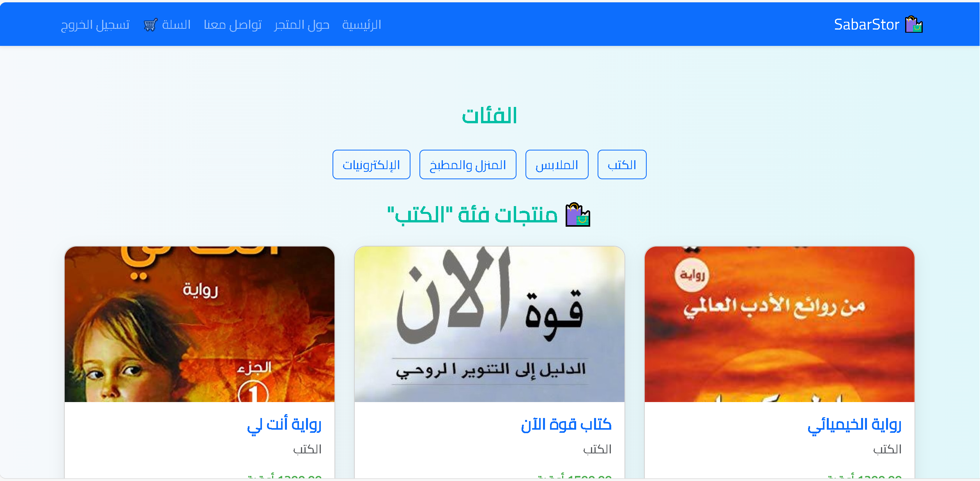
Key Features
User Registration & Login
RTL Arabic Interface
Product Categories
Shopping Cart
Image Upload via Cloudinary
Fully Responsive UI
Dockerized & Deployed on Render
Presentation of Semester Report 21/06/2025
3

Slide 6
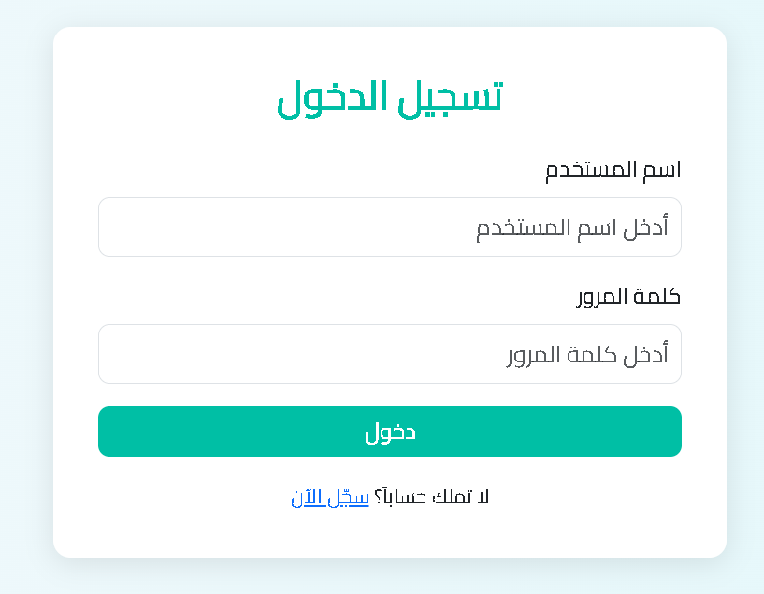
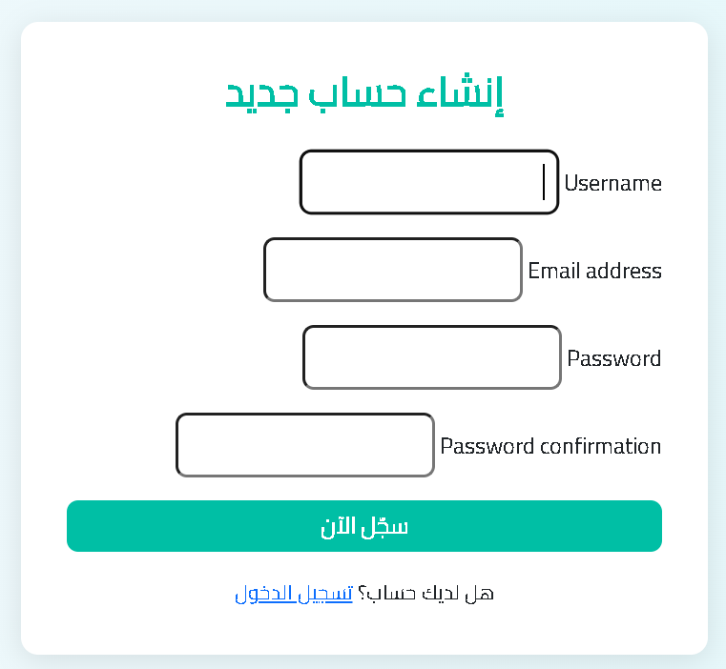
Live Demo/ Screenshots
Presentation of Semester Report 21/06/2025
4

Slide 7
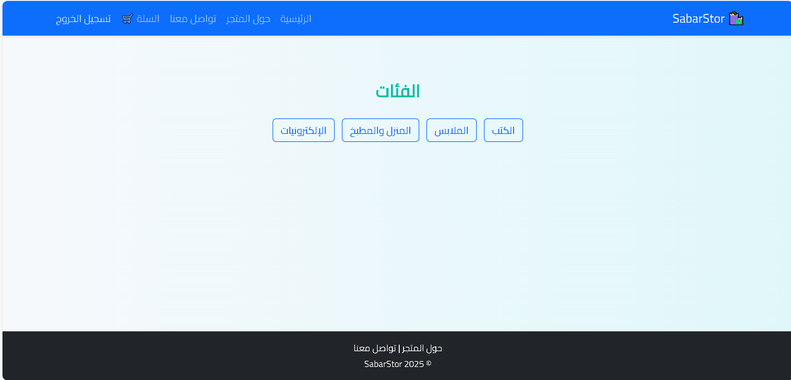
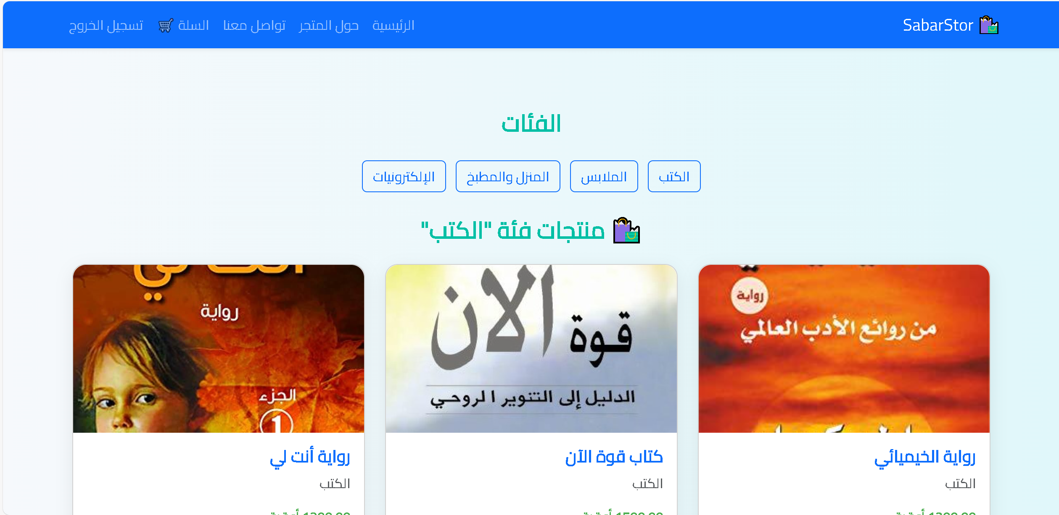
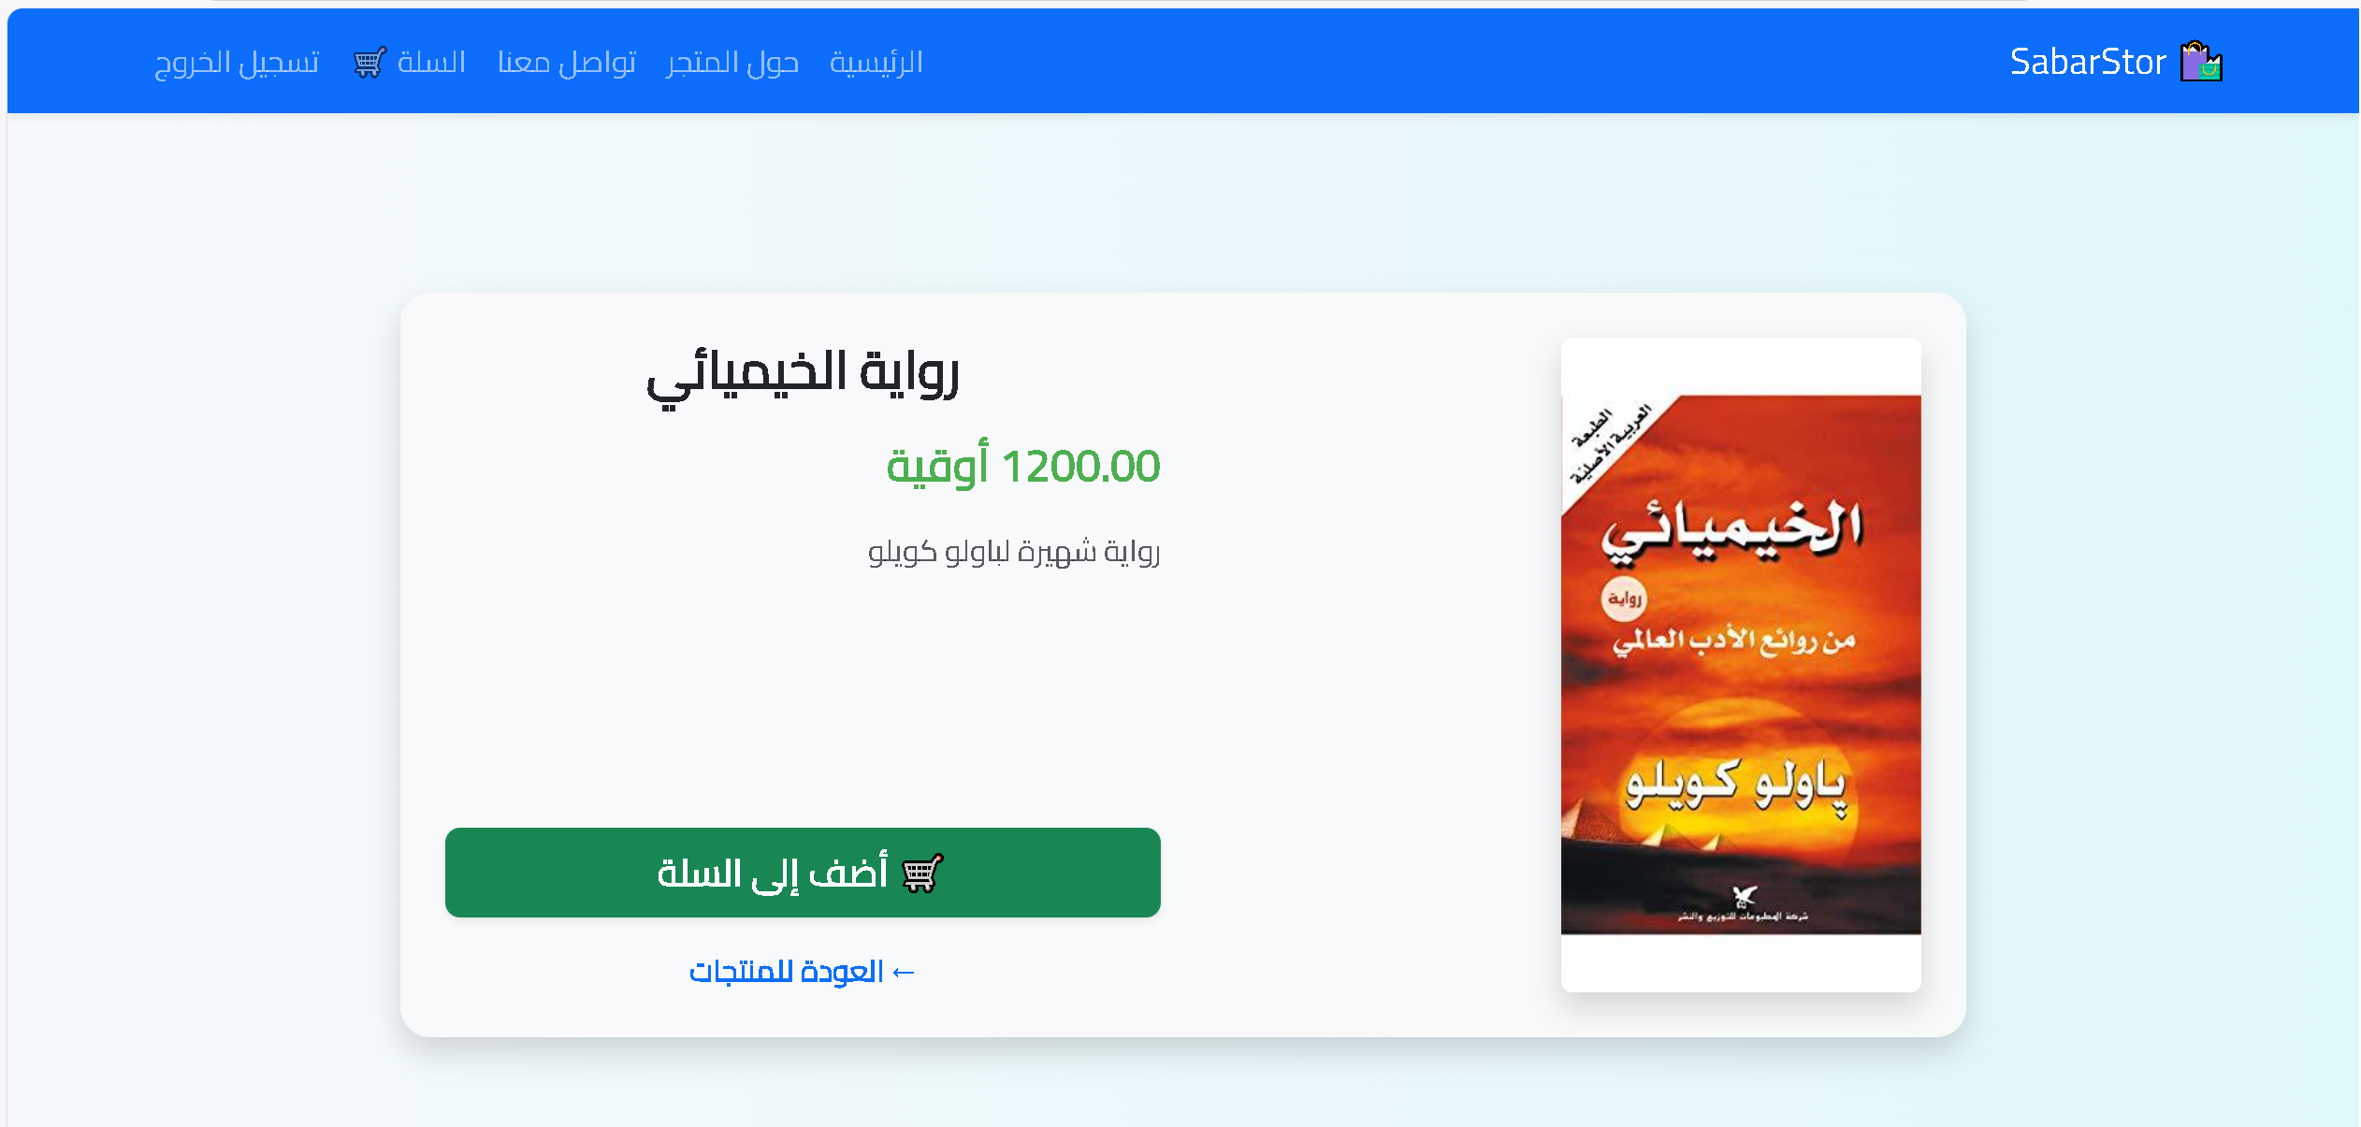
Live Demo/ Screenshots
Presentation of Semester Report 21/06/2025
5

Slide 8
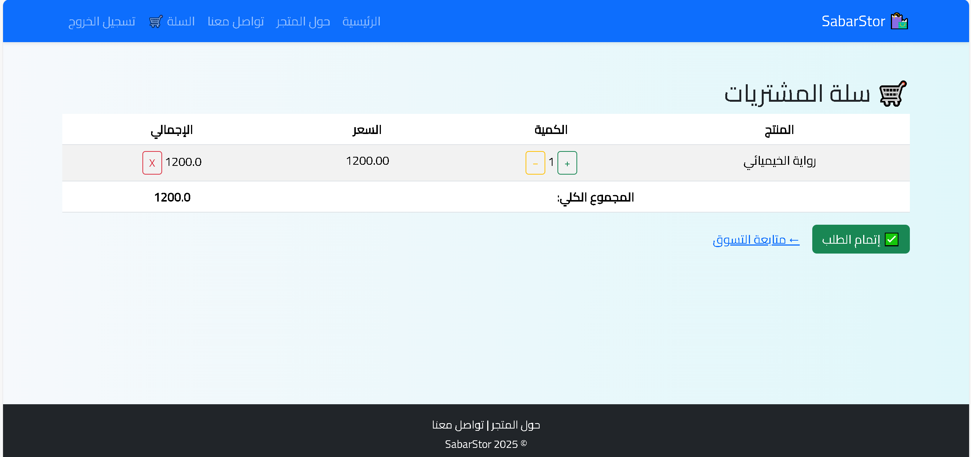
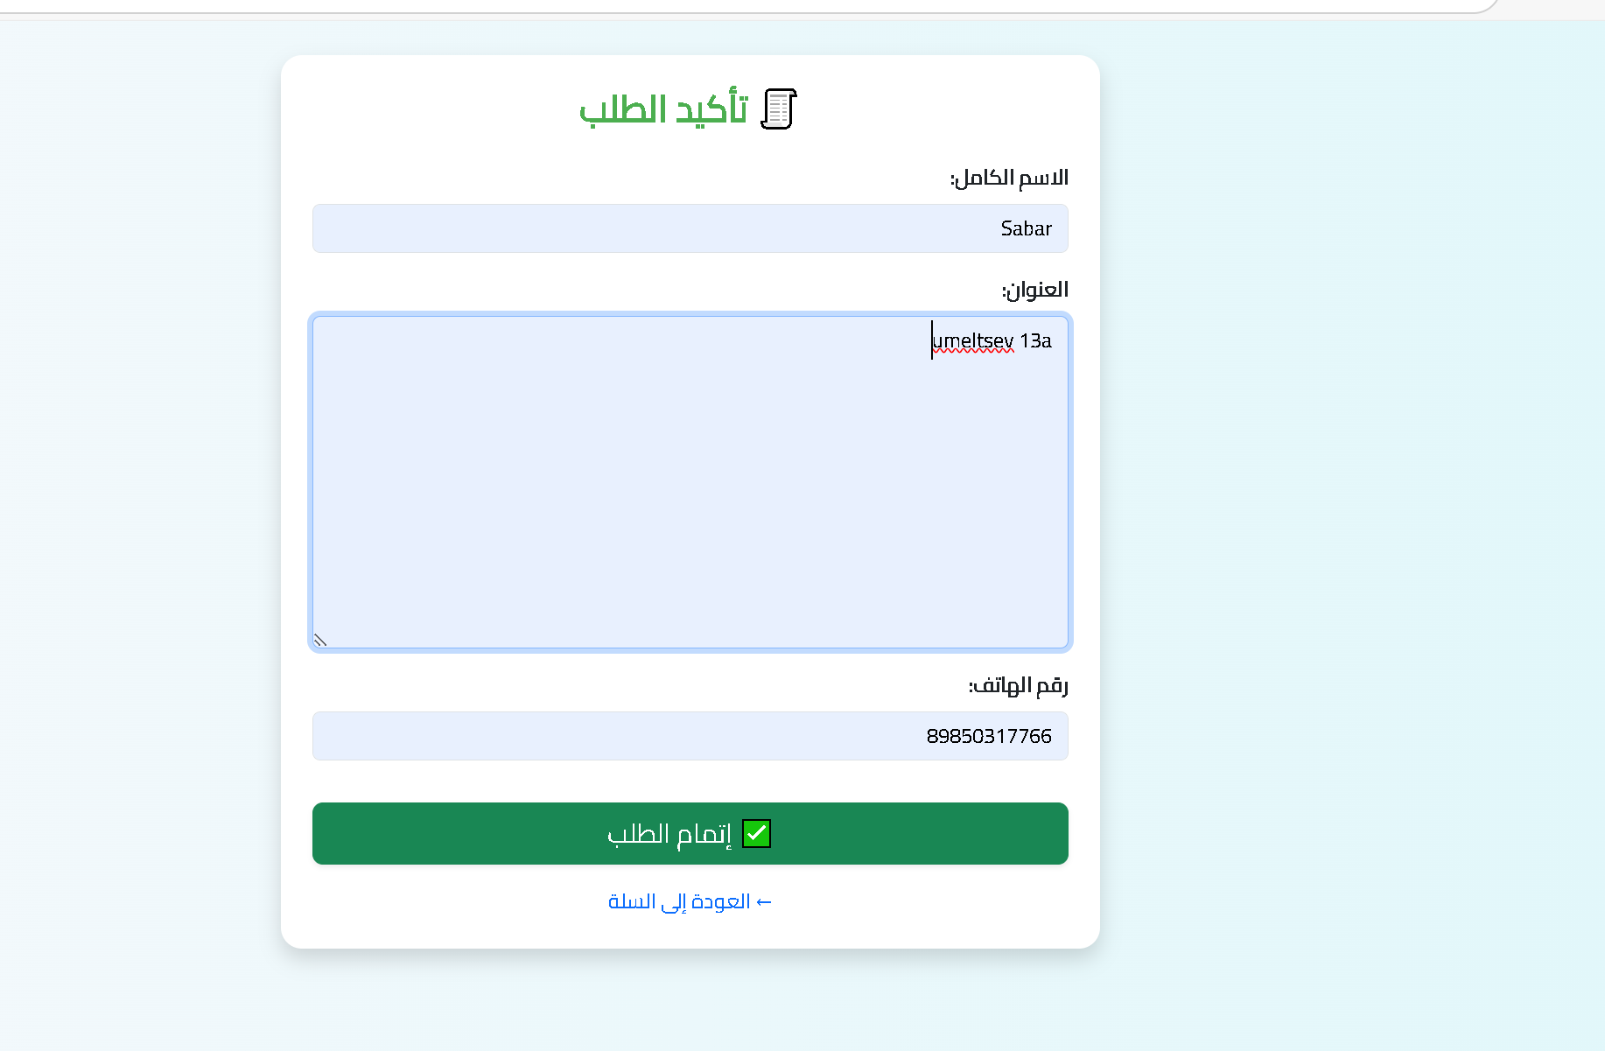
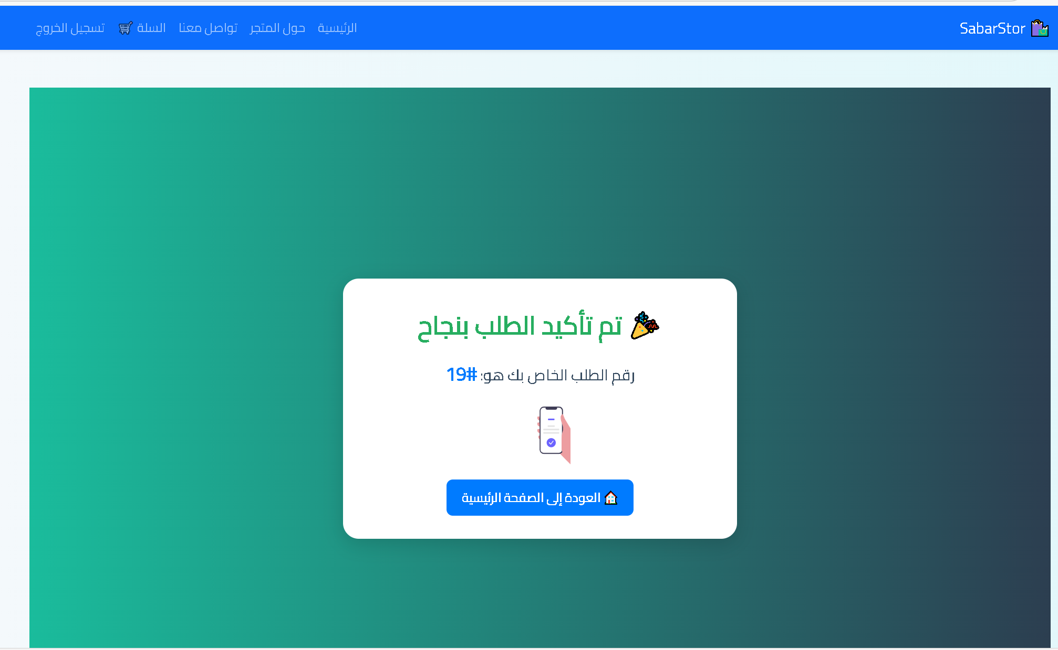
Live Demo/ Screenshots
Presentation of Semester Report 21/06/2025
6

Slide 9
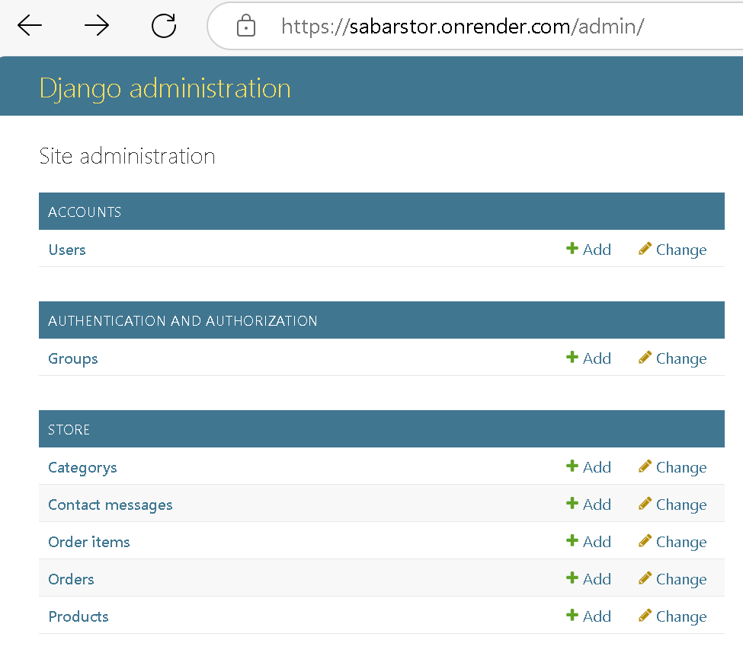
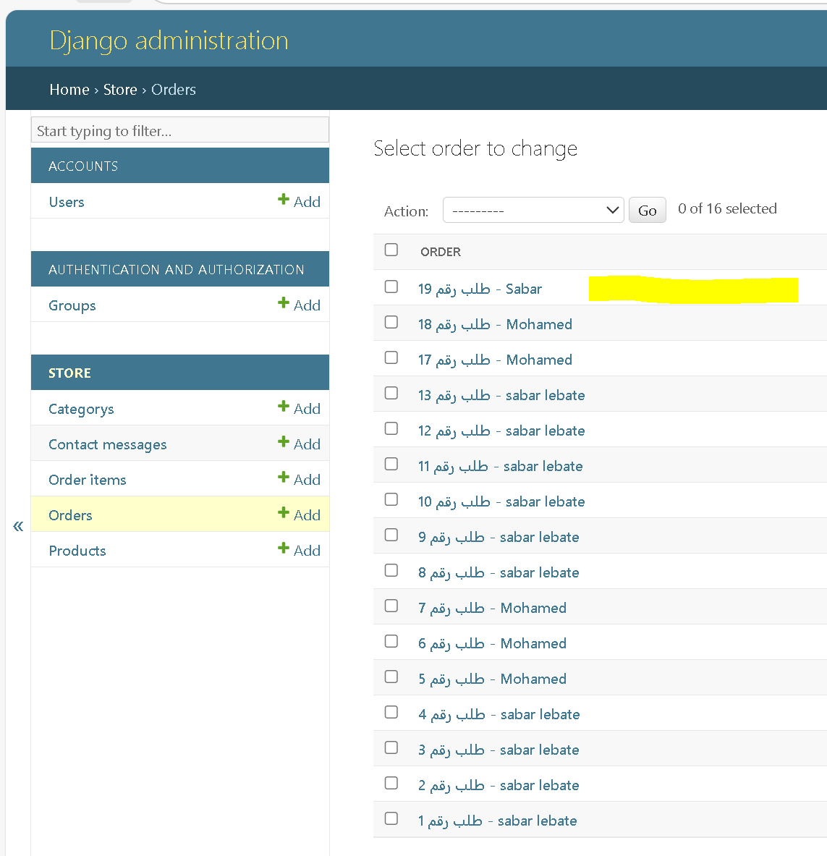
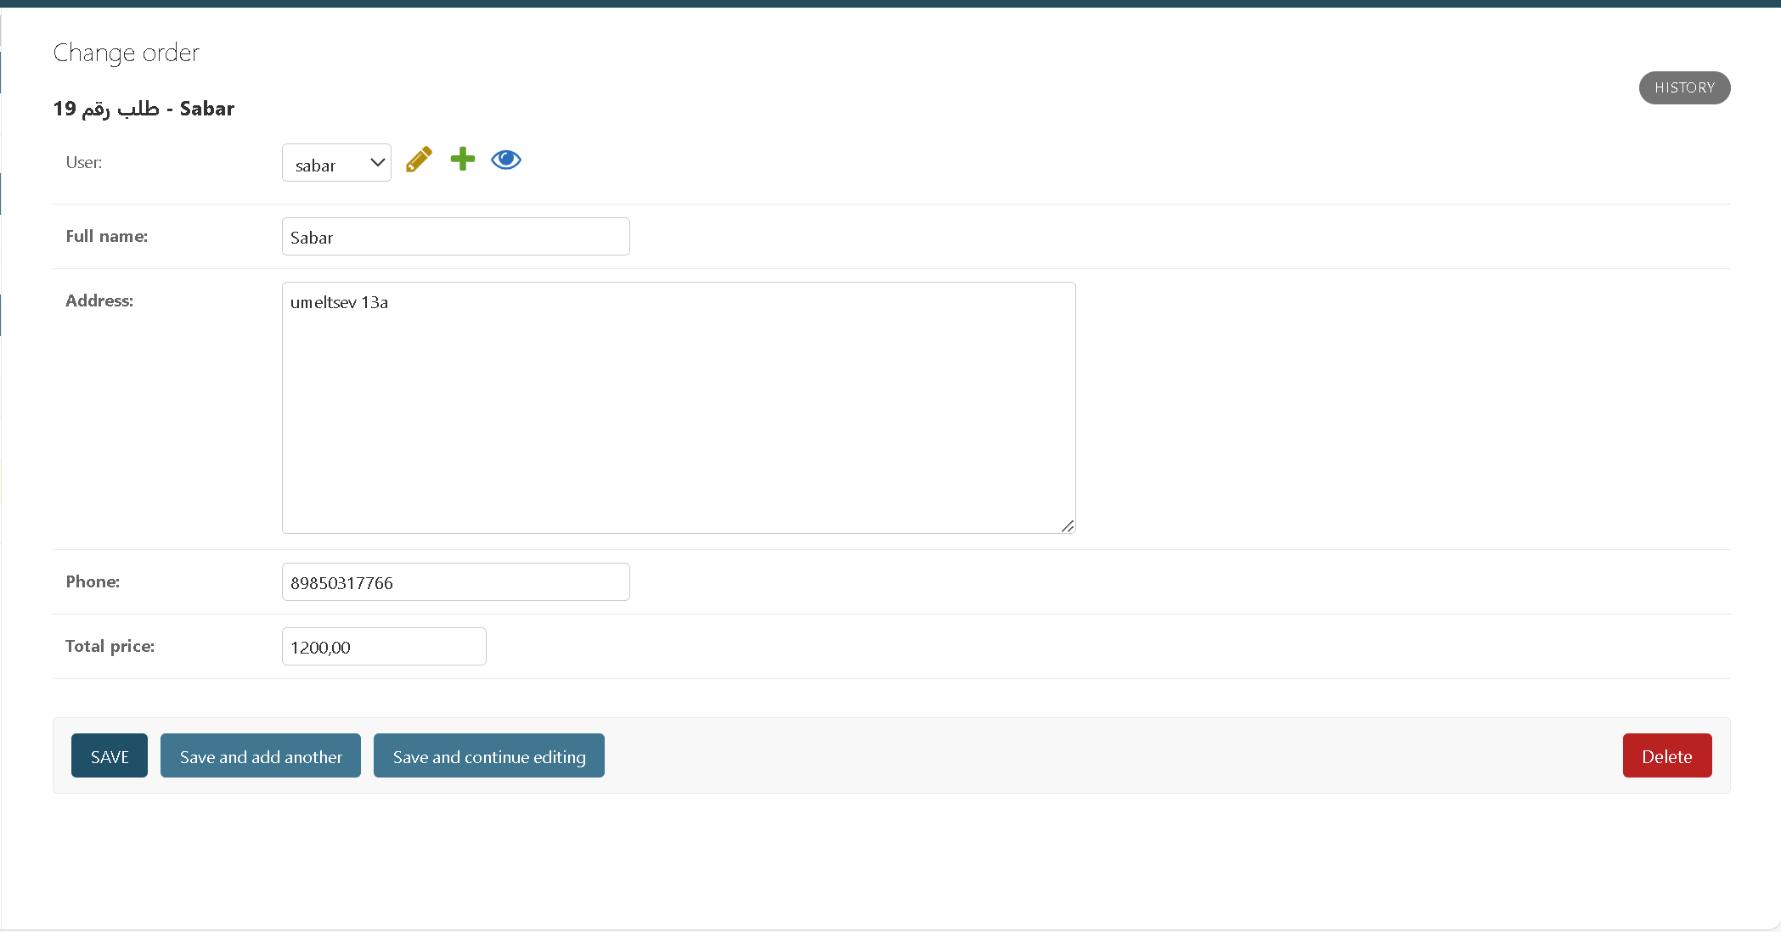
Live Demo/ Screenshots
Presentation of Semester Report 21/06/2025
7

Slide 10
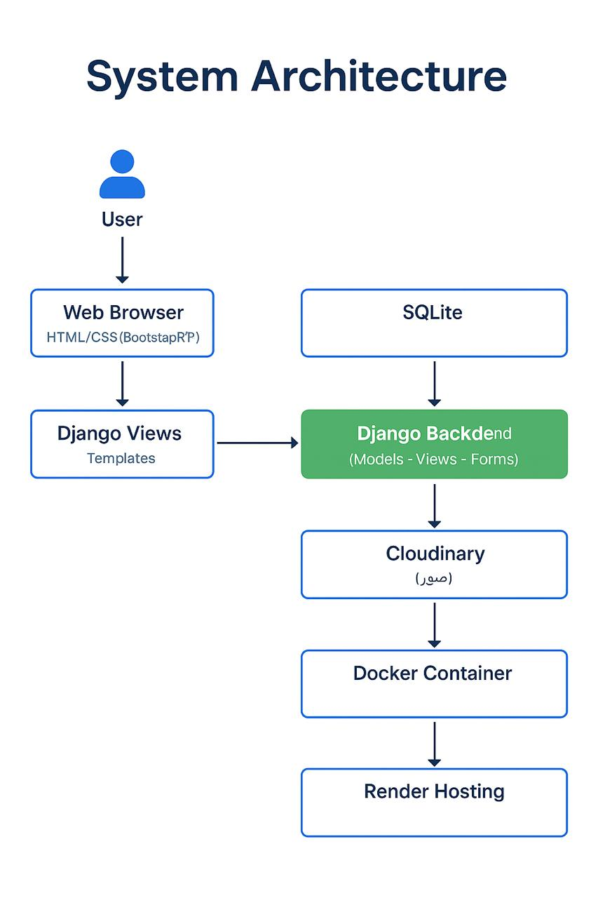
Architecture
The diagram illustrates the flow of data from the user to the backend, image storage, and final deployment using Docker and Render. The system follows a modular and scalable MVC architecture.
Presentation of Semester Report 21/06/2025
8

Slide 11
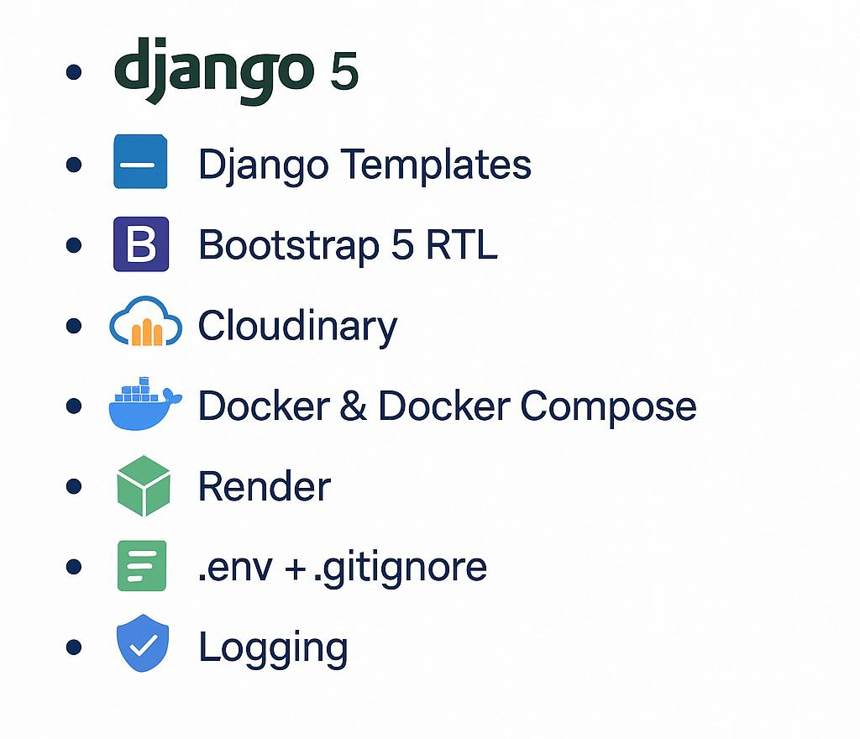
Tools & Technologies Used
Frontend (Templates): using Django Templates + Bootstrap 5 RTL for a responsive interface in Arabic.
Backend (Django): manage programming logic, databases, login, and shopping cart.
Database (SQLite): to save data of users, products, categories (in the development environment).
Cloudinary: to store product images in a professional cloud way.
Docker & Docker Compose: to facilitate the operation of the project in different environments without problems.
Render: for direct publication of the application on the internet.
.env + .gitignore: To hide sensitive data such as passwords and API keys.
Logging: To record important activities such as entry, exit and requests.
Presentation of Semester Report 21/06/2025
9

Slide 12
Testing
✅ User registration and login: Registration and entry forms using true and false data have been successfully tested.
✅ Log out: It was confirmed that the logout process was working and the user was redirected to the appropriate page.
✅ Shopping cart: Adding and deleting products from the basket, storing them according to each user was tested.
✅ @login_required: Sensitive pages have been protected and made sure that unregistered users do not access them.
Presentation of Semester Report 21/06/2025
12
10

Slide 13
Live Demo
🟢 Direct application link: https://sabarstor.onrender.com
Published using the following tools:
Render: To publish the project directly and for free via the cloud.
Docker + Docker Compose: To run the application in a standalone container environment without compatibility problems
.env File: To manage confidential variables such as Cloudinary keys and database
GitHub Repository: The project has been linked to the GitHub repository to facilitate automatic updating and deployment
Observations:
The project is available 24/7 online
Fully supports Arabic interface (RTL)
Publishing has been successfully tried across more than one browser and device
Presentation of Semester Report 21/06/2025
13
11

Slide 14
Analysis & Evaluation
Achieved Objectives
Provide a full Arabic product display and purchase platform
Design a modern, intuitive interface
Support user registration and shopping cart
Enable full interaction up to checkout
Overcome Challenges
⛔ Errors creating users due to CustomUser fixed
🟢 Issues loading CSS, JS fixed by static files reorganizing
⚠️ Env setup issues when deploying addressed
Strengths of the Project
⭐ Fully responsive frontend with Bootstrap RTL
⭐ Secure sensitive pages with @login_required
⭐ Clear organization into apps (Accounts, Store)
⭐ Professional image hosting with Cloudinary
⭐ Easy to run in environments with Docker
⭐ Tests written for core functionalities
Areas for Future Improvement
🟢 Add product rating and review system
🟢 Integrate real payment gateway
🟢 Offer an admin dashboard for order management
🟢 Enhance UX with dynamic effects (JS/AJAX)
Presentation of Semester Report 21/06/2025
14
12

Slide 15
Conclusion & Recommendations
The SabarStor project represents a comprehensive and practical implementation of an Arabic e-commerce platform tailored to the needs of Arabic-speaking users. By leveraging the Django framework and modern tools such as Cloudinary for image hosting and Docker for containerized deployment, It successfully incorporates critical features including user authentication, responsive RTL interface, shopping cart management, and modular application structure. The use of environment variables and secure coding practices further strengthens the application’s stability. Through rigorous testing and real-world deployment on Render, the project has achieved its core goals
Recommendations
Integrate a real payment gateway for transactions.
Add an advanced admin dashboard for managing orders/products.
Develop a mobile companion app using Flutter or React Native.
Integrate analytics tools (exemple: Google Analytics) for user insights.
Enhance interactivity with product ratings and user comments.
Presentation of Semester Report 21/06/2025
15
13

Slide 16
Thank You for Your Attention!
Presentation of Semester Report 21/06/2025
16
14

